Slide 1

Machine Learning Using Python Frameworks
Lorcan Williamson

Slide 2
Overview
Introduction

Slide 3
Introduction
Advances in machine learning, particularly deep learning, in recent years have allowed previously challenging or even impossible programming problems to be solved.
My project aims to look at the current landscape of machine learning through Python frameworks, such as Scikit-Learn and Tensorflow.
Here I am going to cover my plans for this project.

Slide 4
Project plan
To explore the machine learning frameworks I have decided to take 3 examples of common machine learning tasks.
These being; image detection, detecting pneumonia in chest x-rays; classification, predicting student test scores based on a number factors; and regression to forecast bitcoin prices.
Using these example problems I hope to be able to cover a number of features of these frameworks, from data pre-processing to the different machine learning algorithms available within them.

Slide 5
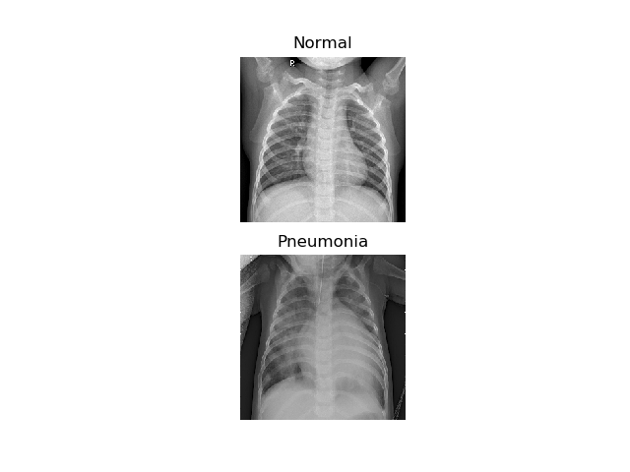
Detecting Pneumonia
Pneumonia is disease that causes an inflammation of the lungs and is responsible for around 5% of deaths in Ireland annually.
Using machine learning, in particular convolutional neural networks, researchers have achieved comparable, or better, detection rate for pneumonia using chest x-rays. Making it a good real-world example application of machine-learning.
This problem should allow for demonstration of CNNs, class balancing, and different accuracy metrics.

Slide 6
Predicting Student Performance
This example problem looks to predict student test scores in two subjects, maths and Portuguese, based on a number of factors, such as their parents occupation, family size, and social life.
This problem was chosen as it should offer a good example of data reduction and augmentation techniques, as there are a lot of data given about each student, some of which probably isn’t useful for predicting grades.

Slide 7
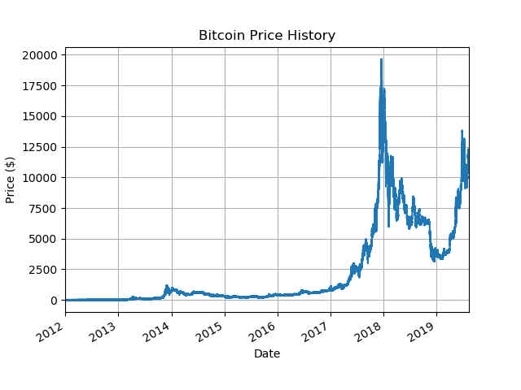
Forecasting Bitcoin Prices.
Bitcoin is a decentralised cryptocurrency released in 2009. Which came into the spotlight in recent years due to its massive increase in value, peaking at around €18,000 in December 2017.
This problem was chosen to demonstrate regression, and forecasting using time-series data. It will also demonstrate handling of data with missing or incomplete entries.

Slide 8

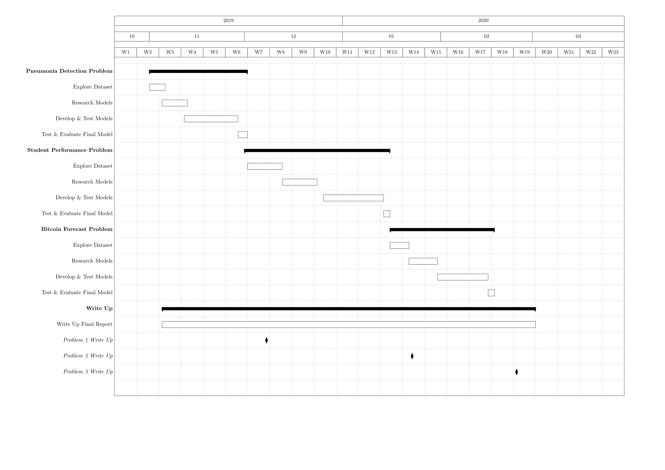



Action Plan

Slide 9
Questions?

